Slide 1
Switching Theory Lab
Mini Project
Part-B
Team members:
Adarsh Chaudhary (1701CS01)
Akshat Jain (1701CS03)

Slide 2
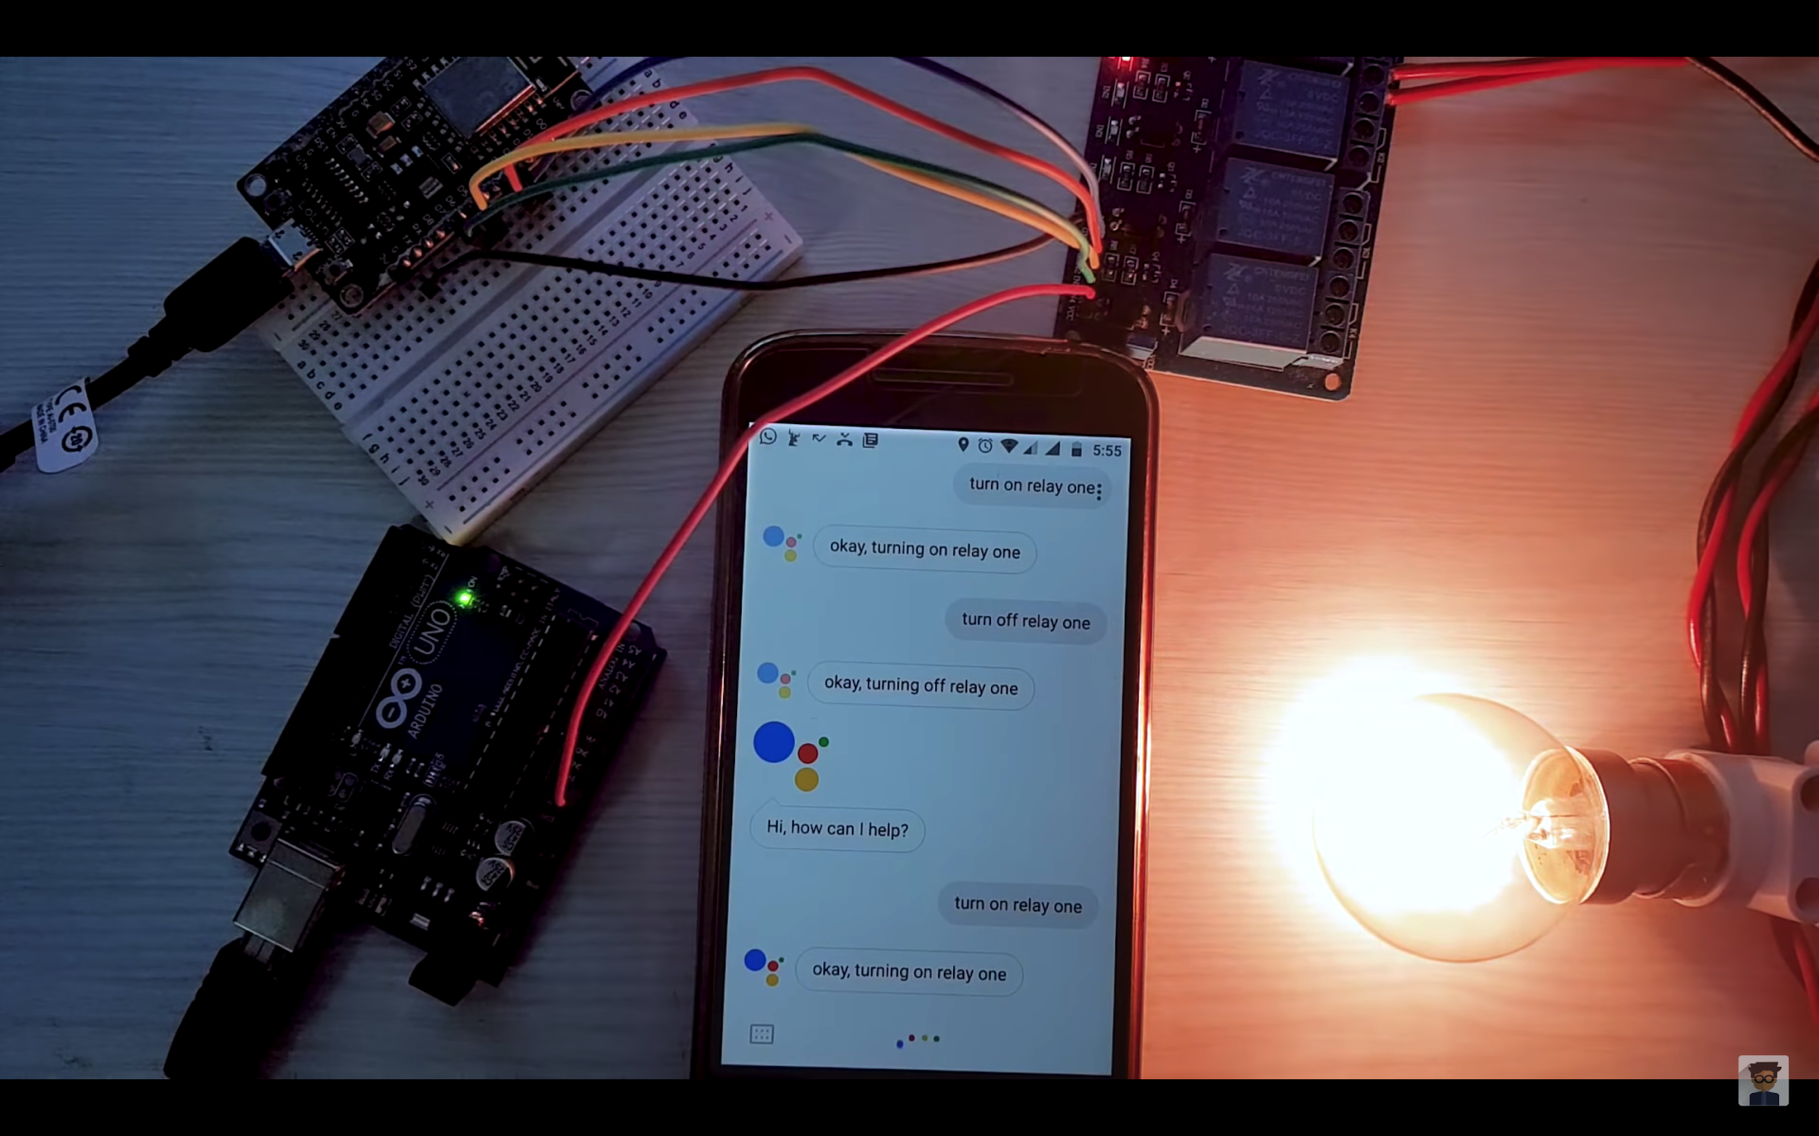
Home Automation System
(using Google Assistant)

Slide 3
Things required
NodeMCU
Relay Board
Jumper Cables
Bread Board
Arduino UNO
Smartphone

Slide 4
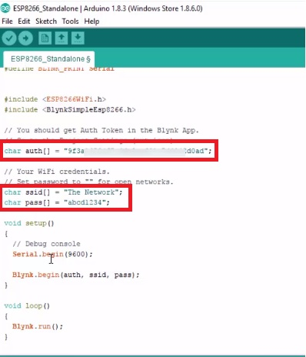
Steps
Download and install the Blynk app on your smartphone.
Download Arduino IDE and install Blynk Libraries on your laptop.
Configure Arduino IDE to use Blynk Libraries.
Go to Files > Examples > Blynk > Boards_WIFI > ESP8266_Standalone. A new file will open.

Slide 5
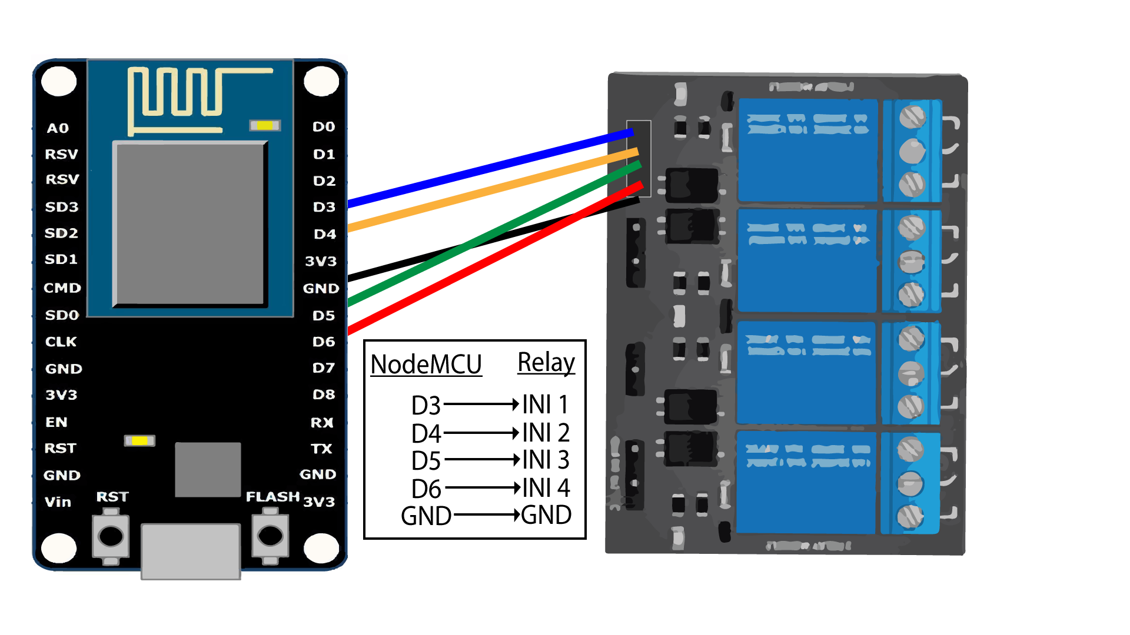
Steps
5. Hardware Assembly: Connect the wires as shown in the schematic diagram below

Slide 6
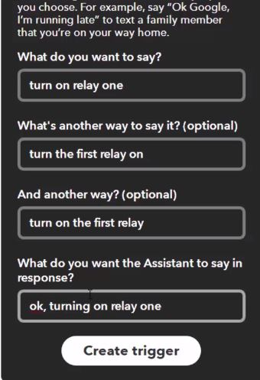
Steps
6. Connect Google Assistant using IFTTT to make the NodeMCU work with voice commands.
7. We can set commands according to our needs.
8. Enjoy the project by controlling the 4 relays using Google assistant as well as Blync app.
# Link to Video Demonstration:
https://drive.google.com/file/d/14GzRLOZIi6Ixx_GFZasjoWhEHd3_yrQo/view?usp=sharing

Slide 7
Thank You! :)

